Slide 1

All for one one for All
Author: Bamshad Shirmohammadi
Supervisor: Professor Arend Hintze

Slide 2
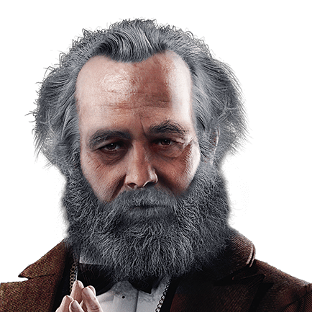
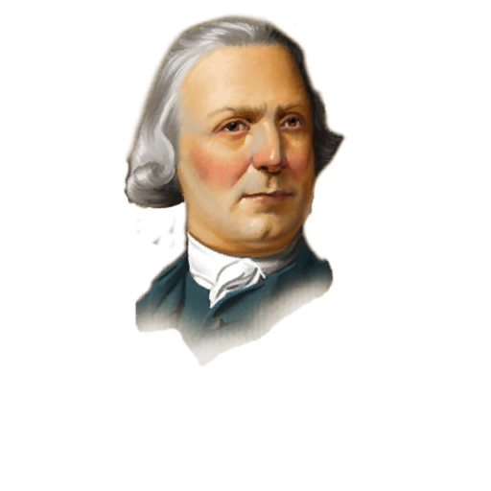
Imagine a school which all the students help the weakest one!
It is a Beautiful dream!
By the way, I am going to establish one of the best schools in the real world!
Can we find a common ground?
WE

Slide 3
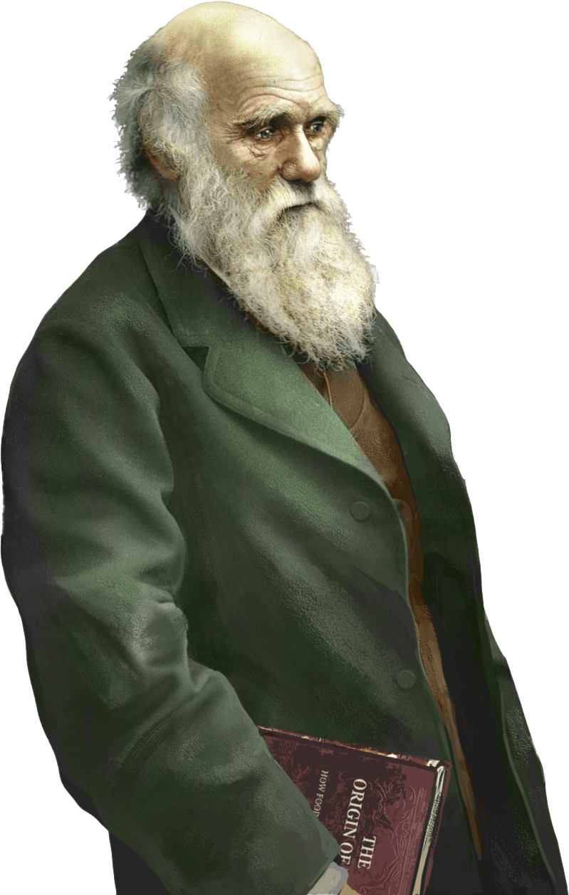
Evolvable artificial robots? I am confused!
We: Yes, it is a bit far fetching in the world of humans but, we are going to do it in world of Artificial Intelligence
You: how?
We: We will check if groups of AI controllers (agents) to perform better individually and in teams at the same time.
For this propose we have used a framework called MABE for creating evolvable artificial robots!

Slide 4
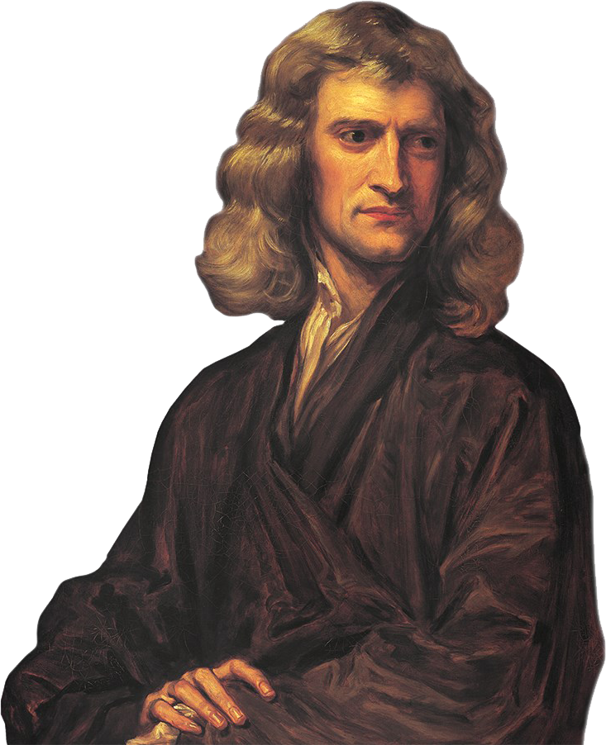
"If I have seen further it is by standing on the shoulders of Giants.”
MABE creates and manages populations of evolving digital organisms which are evaluated in worlds. Using the results of the evaluations new populations are generated by means of natural, artificial, and/or sexual selection.

Slide 5

Group mode:
clonal
and not clonal
Reward sachem:
Individual,
maximum,
minimum,
and average.
Research gap

Slide 6
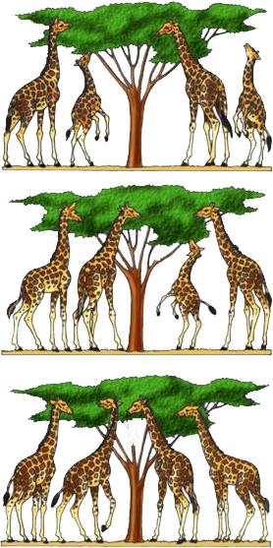
Natural selection
Our world selection
Individual: The one who gain more scores has higher chance to reproduce.
Minimum:
Maximum:
Average:

Slide 7
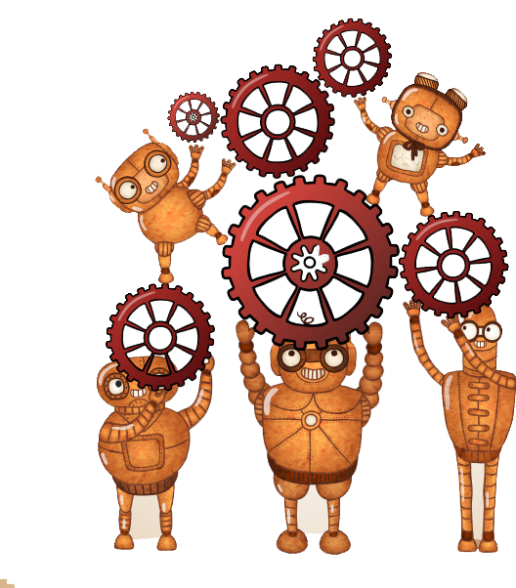
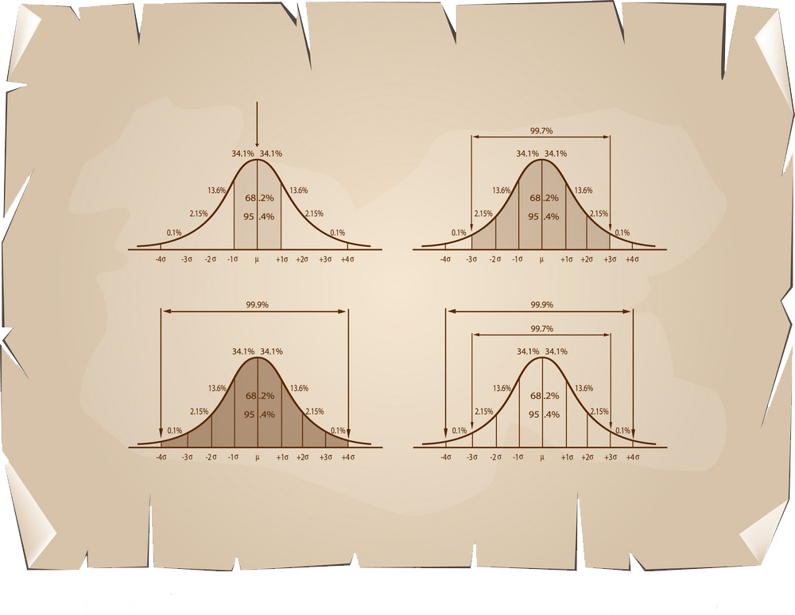
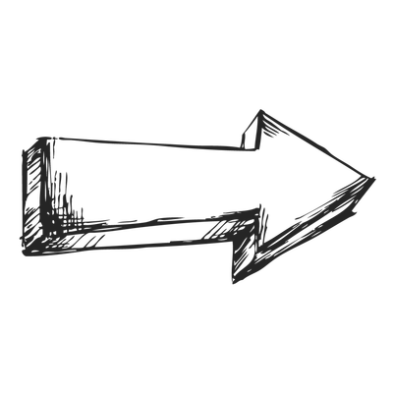


Generation id score
1 14
. . .
. . .
. . .
5000 20000 40

Slide 8
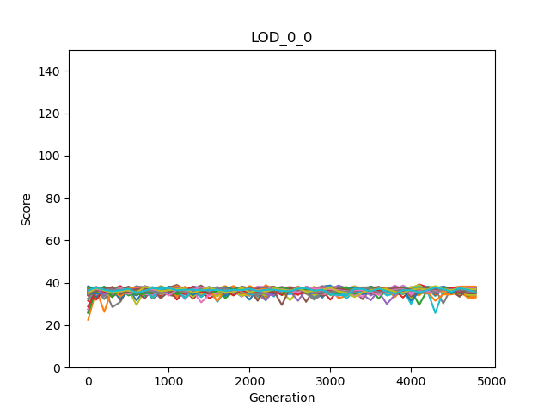
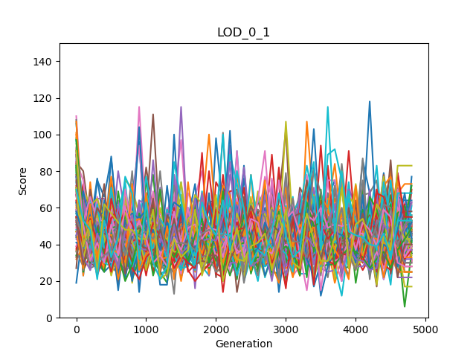
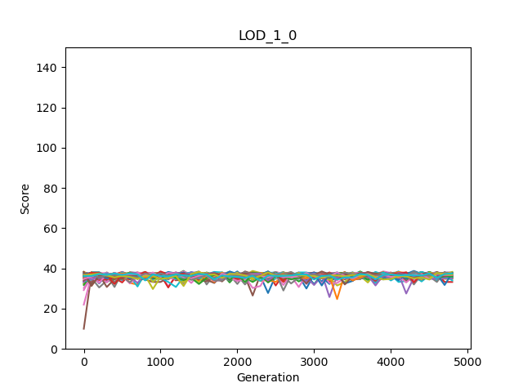
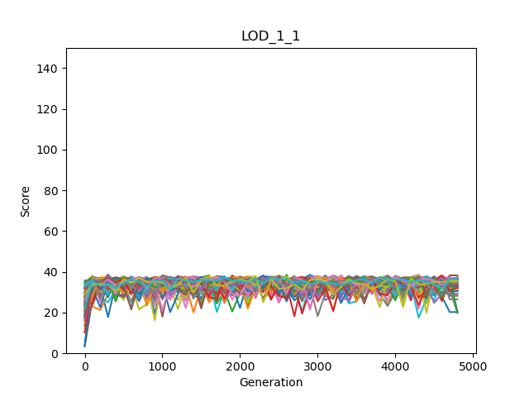
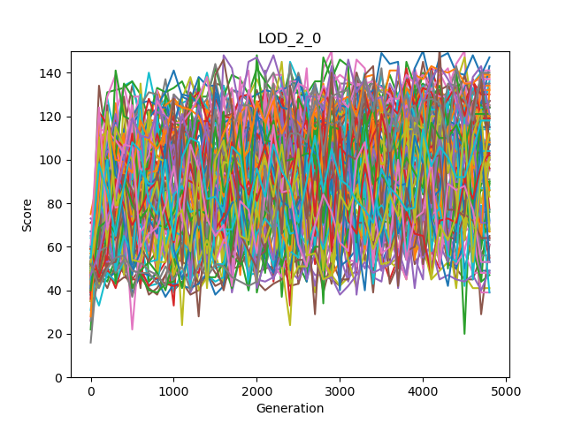
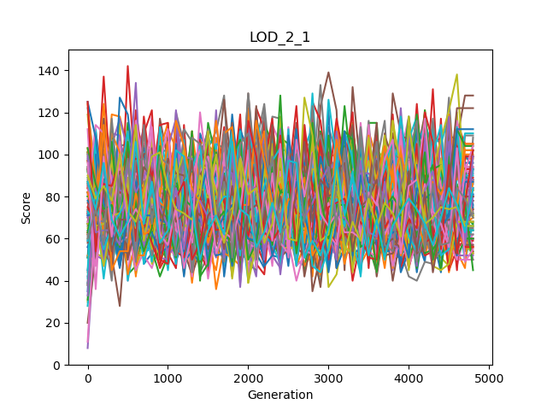
Individual | Clone
Individual | Not Clone
Mean | Clone
Mean | Not Clone
Maximum | Clone
Maximum | Not Clone
Minimum | Clone
Minimum | Not Clone

Slide 9



So, the Marx’ dream and my ideas are both satisfied?
rewardGroupModes | Mean OwnScores | Mean Minimums | Mean Maximums | Mean Averages | Mean Sums
LOD_0_0 Group mode: Clone Reward mode: Individual | 36.4275510 | 26.0175510 | 47.4516326 | 36.4275510 | 145.710204
LOD_0_1 3 Group mode: Not Clone Reward mode: Individual | 44.7497959 | 20.1351020 | 52.0906122 | 36.5244898 | 146.097959
LOD_1_0 2 Group mode: Clone Reward mode: Average | 36.4372959 | 25.8336734 | 47.5702040 | 36.4372959 | 145.749183
LOD_1_1 Group mode: Not clone Reward mode: Average | 47.0285714 | 11.6457142 | 56.7748979 | 33.9260204 | 135.704081
LOD_2_0 Group mode: Clone Reward mode: Maximum | 91.9987755 | 2.70897959 | 91.9987755 | 30.8365306 | 123.346122
LOD_2_1 Group mode: Not clone Reward mode: Maximum | 67.5675510 | 1.56244898 | 75.5930612 | 31.0185204 | 124.074081
LOD_3_0 1 Group mode: Clone Reward mode: Minimum | 30.7763265 | 30.7763265 | 42.3973469 | 36.4311734 | 145.724693
LOD_3_1 Group mode: Not clone Reward mode: Minimum | 34.1008163 | 23.0051020 | 44.5406122 | 33.0433673 | 132.173469
For Markov Brain Agents, yes!
WE

